Slide 1
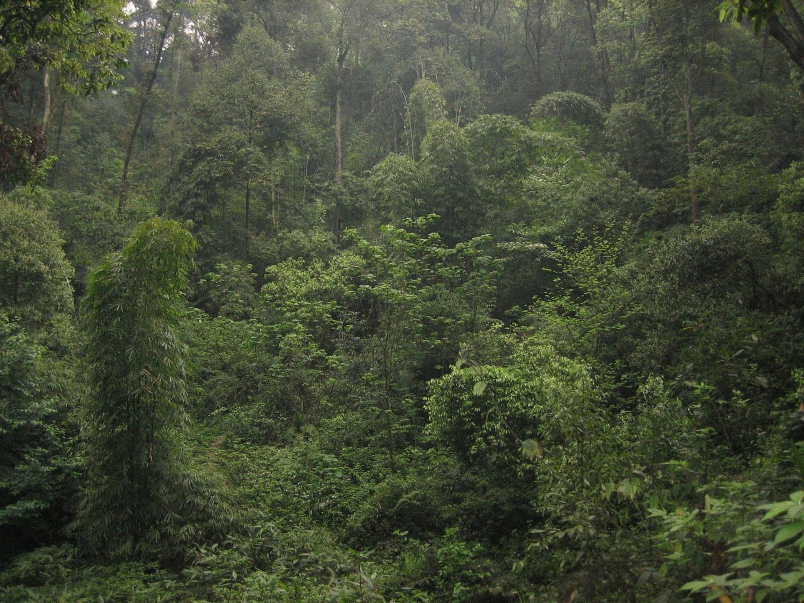
Terrestrial Biosphere
Plant traits and ecosystem modeling
9:00 – 10:30 Biogeochemical cycles modeling & plant traits
Introduction to Dynamic Global Vegetation Models
Traits as characteristics of plants
Plant traits to improve DGVMs
Towards a multivariate spectrum of plant form and function
11:00 – 12:00 Building a simple biogeochemical model (I)
14:00 – 17:00 Building a simple biogeochemical model (II)

Slide 2
The global carbon cycle
Figure 7.3. The global carbon cycle for the 1990s, showing the main annual fluxes in GtC yr–1: pre-industrial ‘natural’ fluxes in black and ‘anthropogenic’ fluxes in red.
Denman, K.L., et al., 2007: Couplings Between Changes in the Climate System and Biogeochemistry. In: Climate Change 2007: The Physical Science Basis. Contribution of Working Group I to the Fourth Assessment Report of the Intergovernmental Panel on Climate Change [Solomon, S., et al. (eds.)]. Cambridge University Press, Cambridge, United Kingdom and New York, NY, USA
Notes:
Figure 7.3. The global carbon cycle for the 1990s, showing the main annual fluxes in GtC yr–1: pre-industrial ‘natural’ fluxes in black and ‘anthropogenic’ fluxes in red (modified from Sarmiento and Gruber, 2006, with changes in pool sizes from Sabine et al., 2004a). The net terrestrial loss of –39 GtC is inferred from cumulative fossil fuel emissions minus atmospheric increase minus ocean storage. The loss of –140 GtC from the ‘vegetation, soil and detritus’ compartment represents the cumulative emissions from land use change (Houghton, 2003), and requires a terrestrial biosphere sink of 101 GtC (in Sabine et al., given only as ranges of –140 to –80 GtC and 61 to 141 GtC, respectively; other uncertainties given in their Table 1). Net anthropogenic exchanges with the atmosphere are from Column 5 ‘AR4’ in Table 7.1. Gross fluxes generally have uncertainties of more than ±20% but fractional amounts have been retained to achieve overall balance when including estimates in fractions of GtC yr–1 for riverine transport, weathering, deep ocean burial, etc. ‘GPP’ is annual gross (terrestrial) primary production. Atmospheric carbon content and all cumulative fluxes since 1750 are as of end 1994.

Slide 3
Uncertainties in carbon cycle feedbacks
Figure 7.14. Uncertainties in carbon cycle feedbacks estimated from analysis of the results from the C4MIP models.
Denman, K.L., et al., 2007: Couplings Between Changes in the Climate System and Biogeochemistry. In: Climate Change 2007: The Physical Science Basis. Contribution of Working Group I to the Fourth Assessment Report of the Intergovernmental Panel on Climate Change [Solomon, S., et al. (eds.)]. Cambridge University Press, Cambridge, United Kingdom and New York, NY, USA
Notes:
Figure 7.14. Uncertainties in carbon cycle feedbacks estimated from analysis of the results from the C4MIP models. Each effect is given in terms of its impact on the mean airborne fraction over the simulation period (typically 1860 to 2100), with bars showing the uncertainty range based on the ranges of effective sensitivity parameters given in Tables 7.4 and 7.5. The lower three bars are the direct response to increasing atmospheric CO2 (see Section 7.3.5 for details), the middle four bars show the impacts of climate change on the carbon cycle, and the top black bar shows the range of climate-carbon cycle feedbacks given by the C4MIP models.

Slide 4
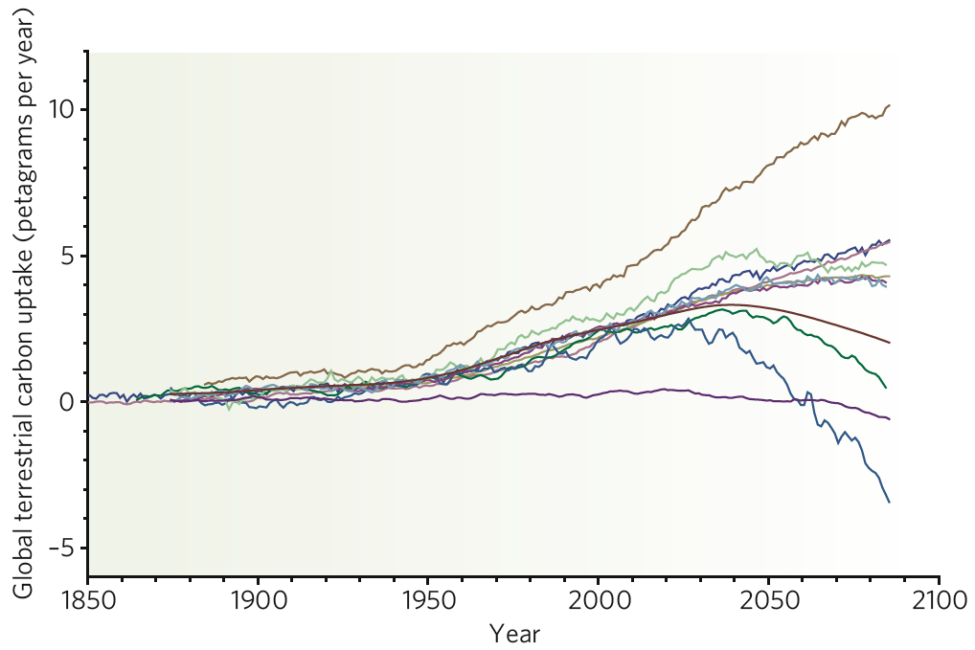
Divergent predictions of
Earth System Models
Unconstrained CO₂
fertilization effect
No CO₂ fertilization effect
Amazon dieback
Friedlingstein et al., 2006; Heimann&Reichstein 2008
Notes:
- Not perfect parameterisation
- Vegetation adaptive capacity
- Species acclimation
- Shift in species composition of the community

Slide 5
The terrestrial biosphere is only a small component of Earth system models: the MPI-Earth System Model
ECHAM6
Carbon
Energy
Momentum
Energy
Momentum
Water
JSBACH
OASIS
Water
HAMOCC
MPIOM
MPI-ESM

Slide 6
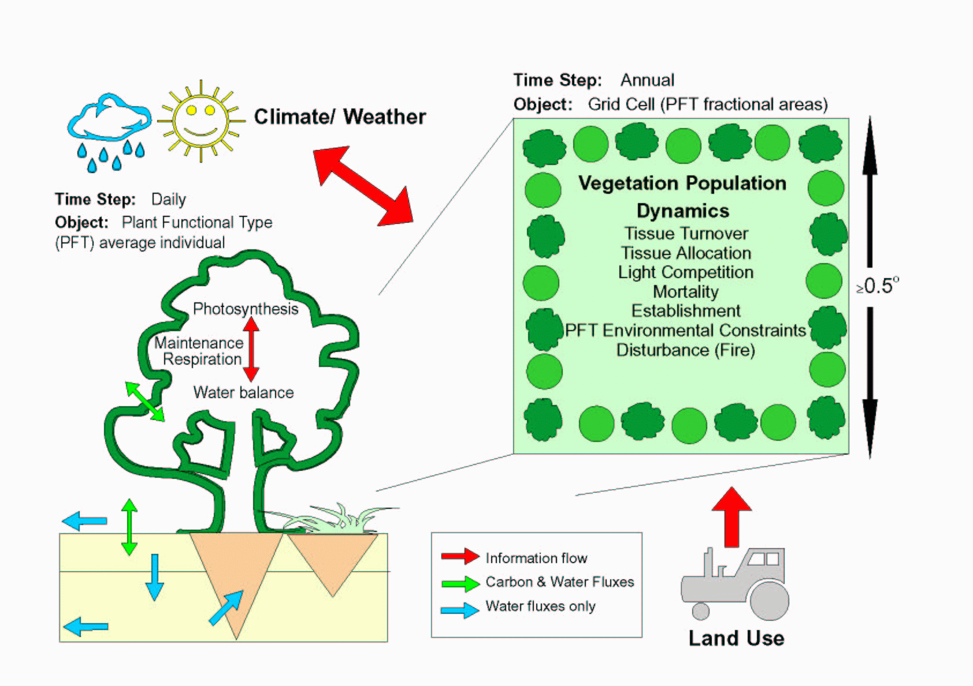
The Lund-Potsdam-Jena Dynamic Global Vegetation Model (LPJ)

Slide 7
LPJ DGVM
Lund Potsdam Jena
Dynamic Global
Vegetation Model
S. Sitch, B. Smith, C. Prentice, A. Arneth, A. Bondeau,
W. Cramer, J. Kaplan, S. Levis, W. Lucht, M. Sykes, K. Thonicke and S. Venevsky, 2003, Global Change Biology

Slide 8
LPJ: Vegetation function and dynamics
Daily time step
Photosynthesis (GPP)
Water Balance
Phenology
Plant respiration
Litter and soil decomposition (monthly)
Annual time step
Tissue turnover
Reproduction cost
Allocation of biomass increment (NPP)
Mortality
Disturbance (Fire)
Establishment

Slide 9
Plant functional types
needle
decid.
boreal
broadl.
evergr.
needle
decid.
broadl.
Tree
temperate
needle
evergr.
broadl.
decid.
tropical
evergr.
temperate (C3)
Herb
tropical (C4)
Notes:
9
Nach vorsichtigen Schätzungen beherbergt unsere Erde circa 320.000 Arten höherer Pflanzen.
Die Systematische Botanik hat die große Leistung vollbracht, einen Großteil der Pflanzenarten zu beschreiben und die Verwandschaftsverhältnisse weitgehend zu entschlüsseln.
Die zentrale und für manche sicher provokative Frage der funktionellen Biodiversitätsforschung ist: Brauchen wir die alle, um die wichtigen Ökosystemfunktionen auf unserem Planeten zu verstehen und zu erhalten?
Ich habe mir gedacht, wir können ja die Modelle fragen, die derzeit genutzt werden, um Ökosystemprozesse global zu beschreiben. Als Beispiel möchte hier ich das weitverbreitete globale dynamische Vegetationsmodell LPJ nennen. Also: Wieviel „Arten“ braucht LPJ?
Unterschieden wird lediglich zwischen Bäumen und Kräutern, grob nach Biomen, nach der Phänologie und der Blattmorphologie. Zählt man die Endpunkte diese Dendrogramms kommt man auf die Zahl 10.
Tatsache ist, dass die Modellierung hilflos ist angesichts der Vielfalt auf unserem Planeten.
Das liegt zum Teil daran, dass die funktionelle Biodiversitätswissenschaft noch ein junger Forschungszweig ist
Die Florenwerke sind geschrieben, aber die Systematisierung der Funktionen hat gerade erst begonnen

Slide 10
LPJ DGVM
general parameters
Sitch et al. 2003

Slide 11
PFT specific parameters
Sitch et al. 2003

Slide 12
PFT Bioclimatic limits
Sitch et al. 2003

Slide 13
Simulated vegetation cover
Natural vegetation
A gridded Earth surface: within each grid cell competition between PFTs
http://www.marietta.edu/~biol/biomes/biome_main.htm

Slide 14
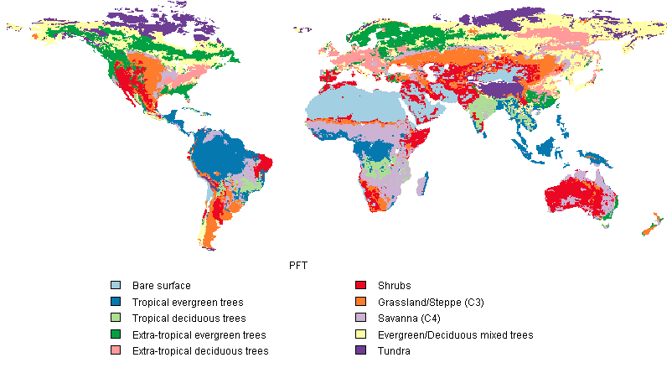
observed distribution based on Ramankutty&Foley (1999)

Slide 15
Simulated net primary production (NPP)
(photosynthesis – plant respiration)
y⁻¹
Sitch et al. 2003

Slide 16
Simulated global fields of soil and vegetation carbon stocks
Sitch et al. 2003

Slide 17
Represented vegetation function and dynamics
Photosynthesis (GPP)
Respiration (plant respiration, litter & soil decomposition)
Water balance (uptake and evapotranspiration)
Allocation of biomass
Phenology, tissue turnover & mortality
Reproduction & establishment
Disturbance (fire)
Not represented
Nutrient limitation (e.g. by N and P)
Adaptation of PFTs to environmental changes

Slide 18
Dynamic Global Vegetation Models (DGVMs) at the MPI-BGC
LPJ (Sitch et al. 2003; C cycle, standard for vegetation dynamics)
JSBACH (Raddatz et al. 2007; C cycle, coupled to climate model ECHAM, CCDAS)
OC-N (Zaehle & Friend 2010, state of the art C and N cycle)
JeDi-DGVM (Kleidon&Mooney 2000; Pavlik et al. 2013; C cycle, next generation functional plant diversity)

Slide 19
Terrestrial Biosphere
Plant traits and ecosystem modeling
9:00 – 10:30 Biogeochemical cycles modeling & plant traits
Introduction to Dynamic Global Vegetation Models
Traits as characteristics of plants
Plant traits to improve DGVMs
Towards a multivariate spectrum of plant form and function
11:00 – 12:00 Building a simple biogeochemical model (I)
14:00 – 17:00 Building a simple biogeochemical model (II)

Slide 20
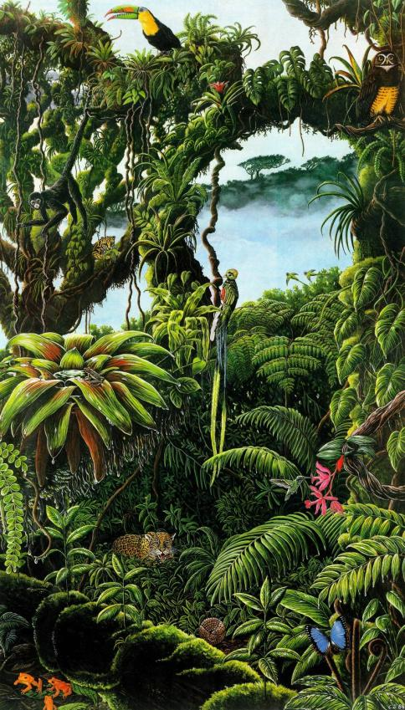
Biodiversity and DGVMs
needle
decid.
boreal
broadl.
evergr.
needle
decid.
broadl.
Tree
temperate
needle
evergr.
broadl.
decid.
tropical
evergr.
temperate
10
Herb
~320.000 Species
tropical
Notes:
20
Nach vorsichtigen Schätzungen beherbergt unsere Erde circa 320.000 Arten höherer Pflanzen.
Die Systematische Botanik hat die große Leistung vollbracht, einen Großteil der Pflanzenarten zu beschreiben und die Verwandschaftsverhältnisse weitgehend zu entschlüsseln.
Die zentrale und für manche sicher provokative Frage der funktionellen Biodiversitätsforschung ist: Brauchen wir die alle, um die wichtigen Ökosystemfunktionen auf unserem Planeten zu verstehen und zu erhalten?
Ich habe mir gedacht, wir können ja die Modelle fragen, die derzeit genutzt werden, um Ökosystemprozesse global zu beschreiben. Als Beispiel möchte hier ich das weitverbreitete globale dynamische Vegetationsmodell LPJ nennen. Also: Wieviel „Arten“ braucht LPJ?
Unterschieden wird lediglich zwischen Bäumen und Kräutern, grob nach Biomen, nach der Phänologie und der Blattmorphologie. Zählt man die Endpunkte diese Dendrogramms kommt man auf die Zahl 10.
Tatsache ist, dass die Modellierung hilflos ist angesichts der Vielfalt auf unserem Planeten.
Das liegt zum Teil daran, dass die funktionelle Biodiversitätswissenschaft noch ein junger Forschungszweig ist
Die Florenwerke sind geschrieben, aber die Systematisierung der Funktionen hat gerade erst begonnen

Slide 21
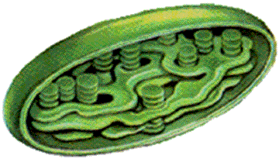
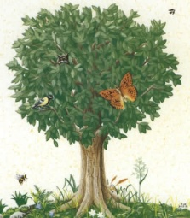
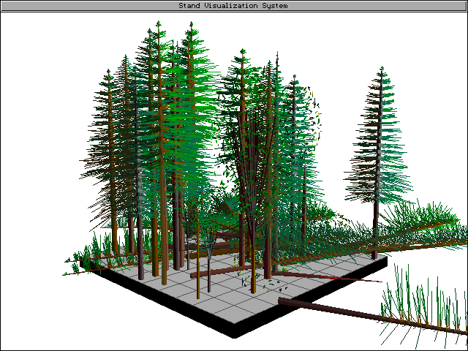




Plant Traits
Physiology
Morphology
Demography
Ecosystem
Assimilation rate
Photosynthesis type
Respiration rates
Stomatal conductance
Leaf longevity
Nutrient concentrations
Secondary chemistry
Stomata density
Frost tolerance
Shade tolerance
Nutrient acquisition rates
Retranslocation
N-fixation capacity
…
Specific leaf area
Leaf density
Leaf form
Wood density
Vessel diameter
Sapwood fraction
Maximum rooting depth
Specific root length
Max. height
Max. diameter
Bark thickness
Crown transparency
…
Longevity
Mortality rate
Fire resistance
Relative growth rate
Seed mass
Seed terminal velocity
Seed longevity
Serotiny
Time to maturity
Fecundity
Mast cycles
Resprouting capacity
…
Leaf decomposition rate
Wood decomposition rate
Interception
Mycorrhizal assocation
VOC emission
Palatability
Browsing susceptibility
…
Notes:
(update of yellow!)
Um welche Merkmale geht es? Es geht um viele.
Hier sehen sie unsere derzeitige Wunschliste. Sie sollen nicht die einzelnen Einträge lesen. Nur soviel: Die Merkmale fallen grob in 4 Gruppen: Physiologische, Morphologische, Demographische Merkmale und schließlich solche, die erst im Zusammenwirken mit anderen Organismengruppen (Symbionten, Herbivoren) zum Tragen kommen. Die gelb unterlegten sind Merkmale, die wir im Rahmen von laufenden Projekten bearbeiten.
Wir kämpfen also an verschiedenen Fronten.
Der linke obere Block zu Photosynthese und Atmungsparametern betrifft die sehr interessante Arbeit von Jens Kattge aus meiner Gruppe, der unter Herrn Esser promoviert hat. Mit diesen „fremden“ Federn möchte ich mich aber heute nicht schmücken.

Slide 22



Start in 2007
Fast Track Initiative on Refining Plant Functional Classifications
Sandra Díaz
Sandra Lavorel
Colin Prentice
Paul Leadley
Christian Wirth
Jens Kattge
Gerhard Bönisch
Goal: A global database of plant traits to improve the representation of functional diversity in the context of DGVMs
Notes:
Goal: development of a plant trait database with global coverage for a range of traits relevant for vegetation modeling
Make the data available for the scientific community
The effort has been christened TRY - an expression of sentiment and attitude rather than an acronym

Slide 23
TRY – a global database of plant traits
Second generation of data pooling
Fang
SID
Chapin
FET
ZLTP
Reich
BROT
Wright
Glopnet
1100 traits
100000 species
2.2 million plants
5.6 million trait records
ECOCRAFT
Craine
WoodDensity
Garnier
KewGardens
TRY
Ordonez
CEDAR-CREEK
Cornelissen
CORDOBASE
Leishman
BIOPOP
Enquist
RAINFOR
Moles
ECOQUA
Penuelas
DIVERSUS
Shipley
BiolFlor
Zanne
VISTA
LEDA
Díaz
Notes:
23
Im letzten Jahr haben sich die Dinge dann sehr stürmisch entwickelt. Wir sind eingebunden in ein internationales Projekt mit dem Namen TRY, das sich zum Ziel gesetzt hat, die global vorhanden Merkmalsdatenbanken physikalisch zu vereinigen. Diese physikalische Zusammenführung erfolgt durch unsere Gruppe in Jena. Integriert werden sowohl bestehende Datenbanken wie z. B. LEDA als auch Datenbanken einzelner Forscher. Besonders möchte ich die Mitwirkung von Kollegen von Kew Gardens erwähnen, von denen bislang quantitativ die meiste Information kommt.
Derzeit sind wir bei 1.7 Millionen Einträgen von über 30.000 Pflanzenarten

Slide 24
Trait entries by plant parts

Slide 25
TRY – a global research network
167 institutes contributing data
12,361 measurement sites (50% of data georeferenced)

Slide 26
Data processing & quality control
Semantic integration of traits, context information and taxonomy
Standardization of units
Correction of errors
Identification of duplicates and outliers

Slide 27
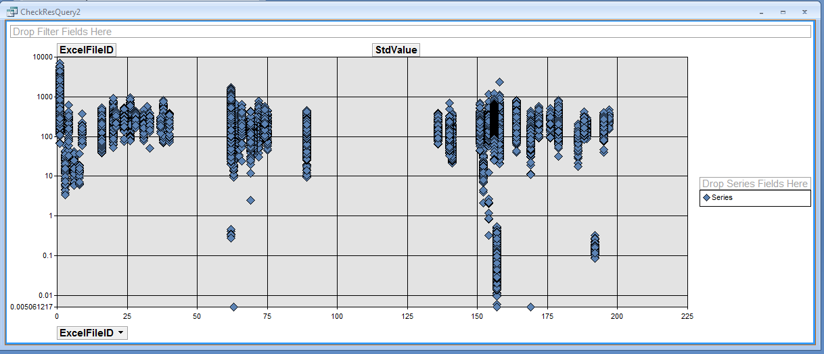
Something‘s wrong here
e.g. specific leaf area

Slide 28
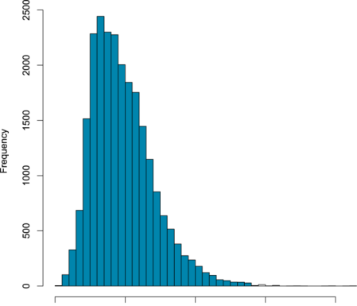
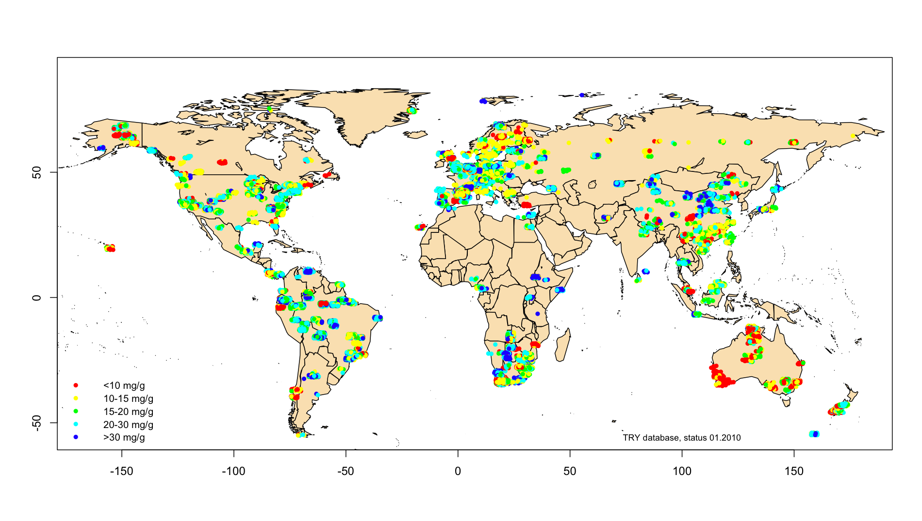
e.g. Leaf nitrogen
51 contributions
42911 entries
31108 geo-referenced
7019 species
2
4
6
8
[%]

Slide 29
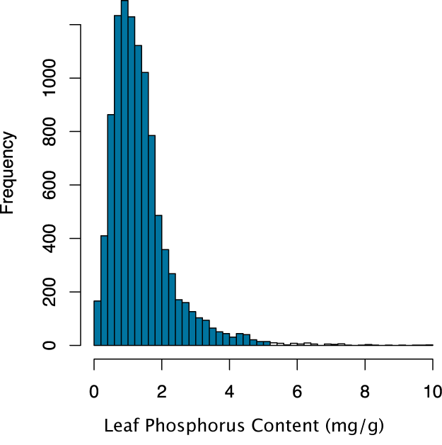
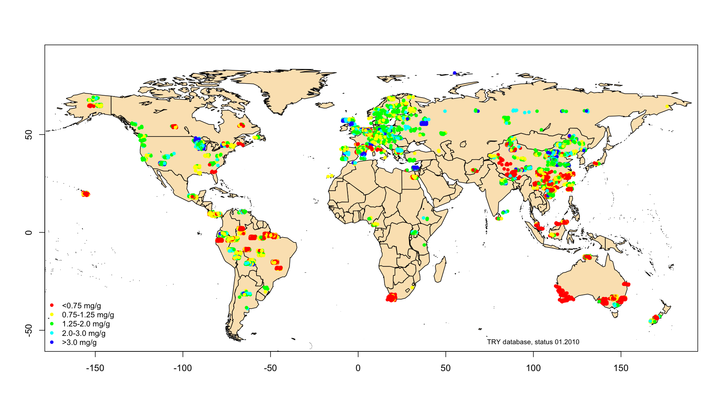
e.g. leaf phosphorus
29 contributions
19323 entries
14024 geo-referenced
4324 species

Slide 31
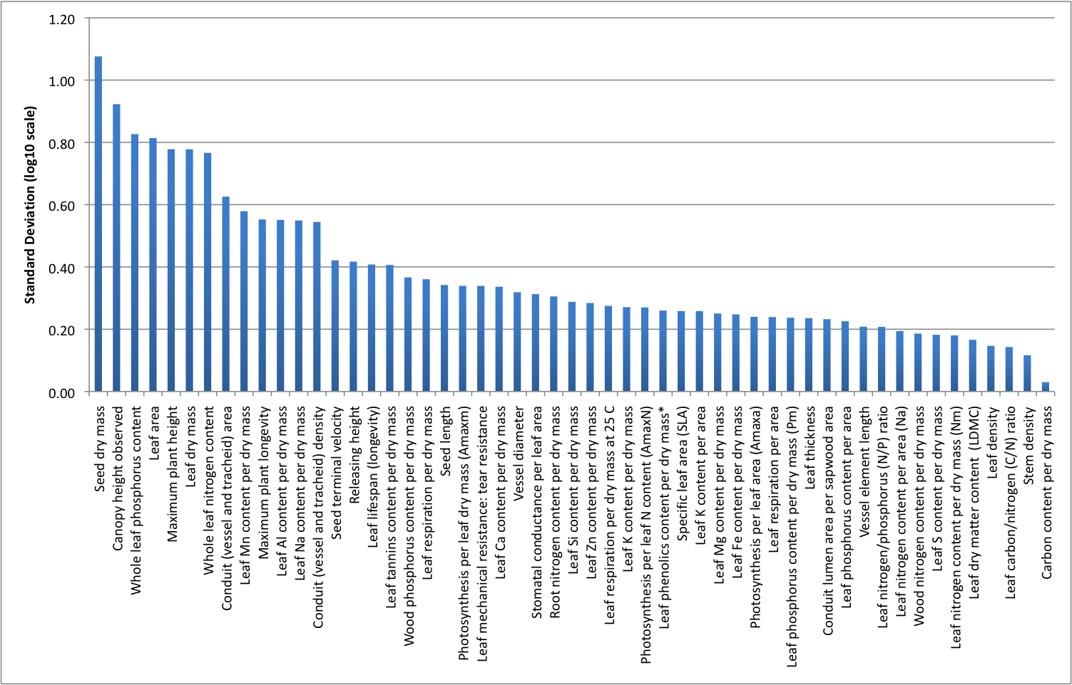
Range of variation
Heighest: Seed mass (mean -98% to +1000%)
Lowest: Carbon content per dry mass (mean ±8%)

Slide 32
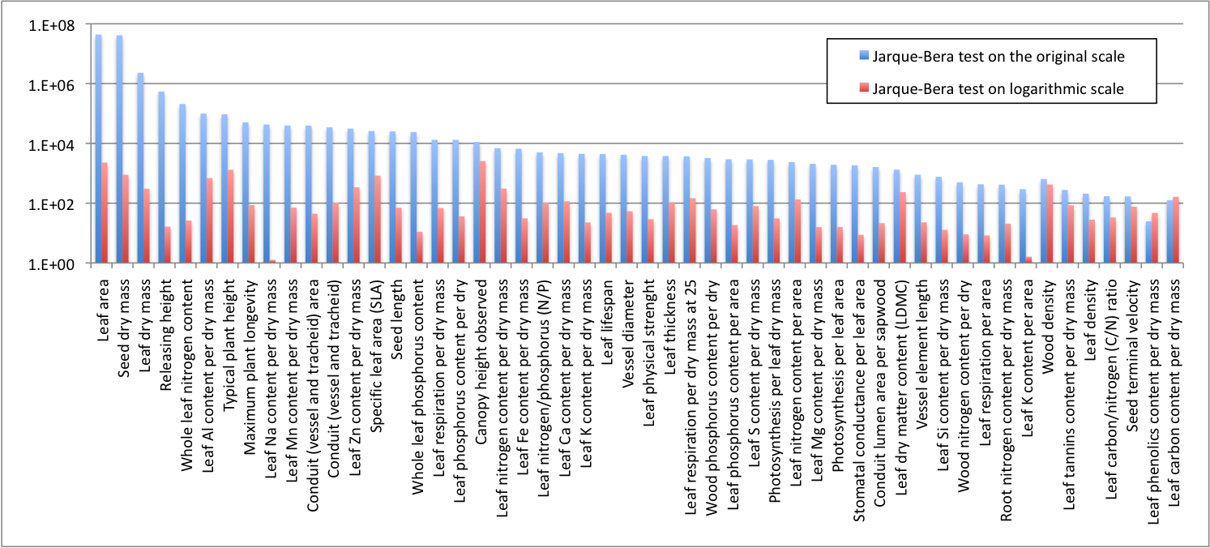
For 50 out of 52 traits normality is improved by log-transformation
Most plant traits are approximately log-normal distributed

Slide 33
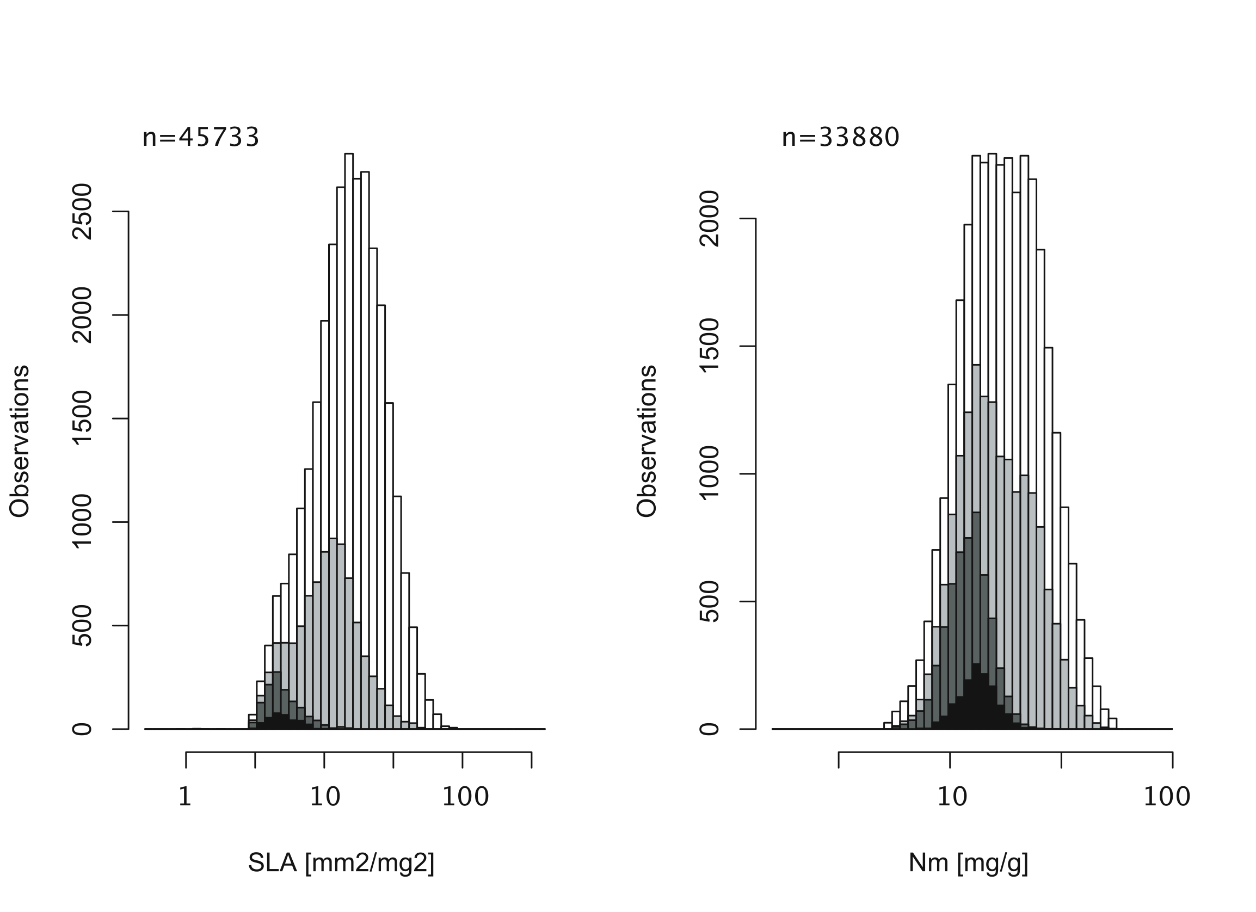
Looking into detail: Variation within species and PFT
Specific leaf area Leaf nitrogen concentration
Trees
Trees needle-
leaved evergreen
Pinus sylvestris
(1462 entries)
Trees
Trees needle-
leaved evergreen
Pinus sylvestris
(484 entries)
Kattge et al. (2011)
Global Change Biology

Slide 34
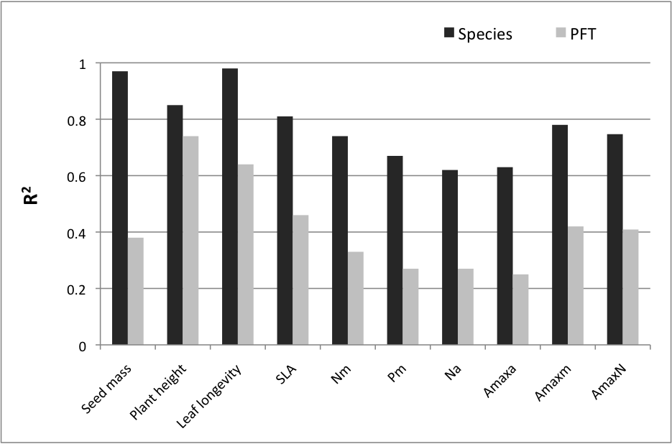
Fraction of explained variance
Kattge et al. (2011) Global Change Biology

Slide 35
SLA distribution versus model parameter values

Slide 36
O-CN predictions of LeafN concentration versus observed ranges

Slide 37
Terrestrial Biosphere
Plant traits and ecosystem modeling
9:00 – 10:30 Biogeochemical cycles modeling & plant traits
Introduction to Dynamic Global Vegetation Models
Traits as characteristics of plants
Plant traits to improve DGVMs
Towards a multivariate spectrum of plant form and function
11:00 – 12:00 Building a simple biogeochemical model (I)
14:00 – 17:00 Building a simple biogeochemical model (II)

Slide 38
Two examples using plant trait data for model improvement
Improving litter decomposition in LPJ
Brovkin V, P. M. van Bodegom, T. Kleinen, C. Wirth, W. Cornwell, J. H. C. Cornelissen, J. Kattge (2012) PFT driven variation in decomposition rates improves projections of global litter stock distribution. Biogeoscience
Introducing adaptation of traits to the environment in JSBACH
Verheijen, LM, V Brovkin, R Aerts, G Bönisch, JHC Cornelissen, J Kattge, PB Reich, IJ Wright, PM van Bodegom (2013) Impacts of trait variation through observed trait-climate relationships on performance of a representative Earth System model: a conceptual analysis. Biogeosciences

Slide 39
Improving litter decomposition in LPJ
Original parameters
in LPJ:
one parameter for litter decomposition
Sitch et al. 2003

Slide 40
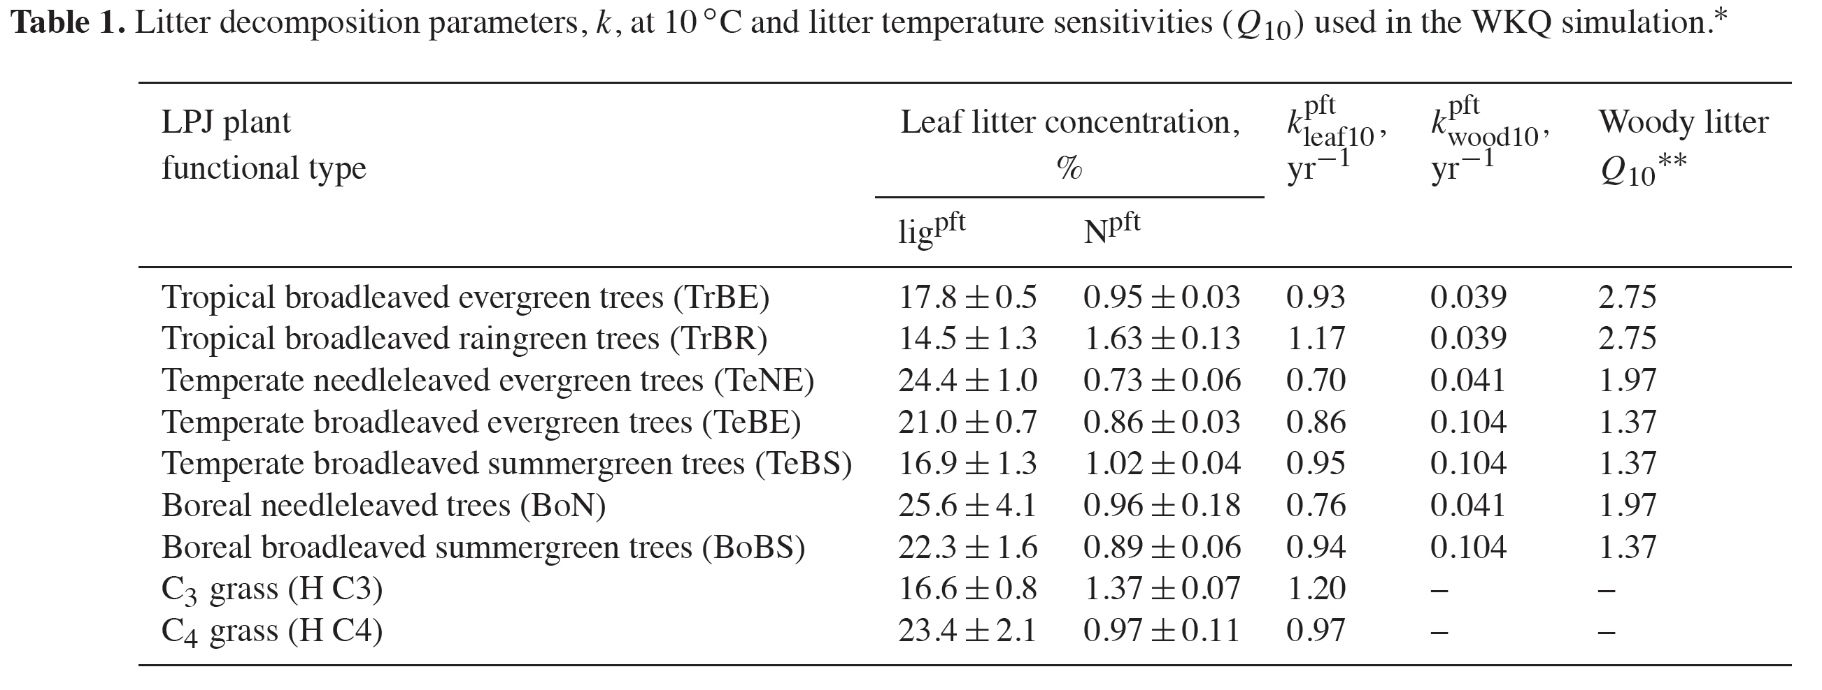
Trait based PFT specific parameters for litter decomposition

Slide 41
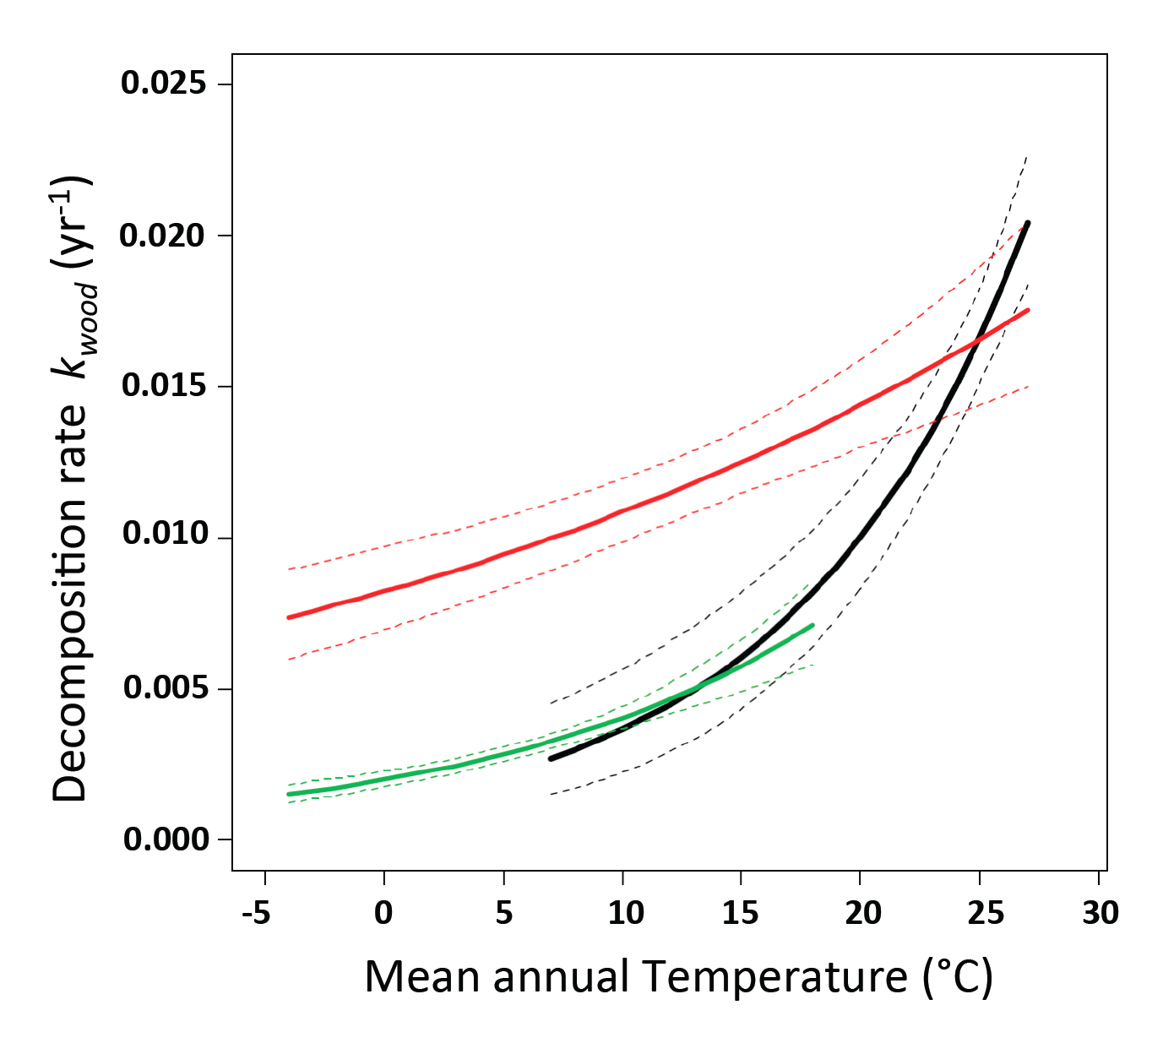
Temperature dependency of woody litter decomposition rates

Slide 42
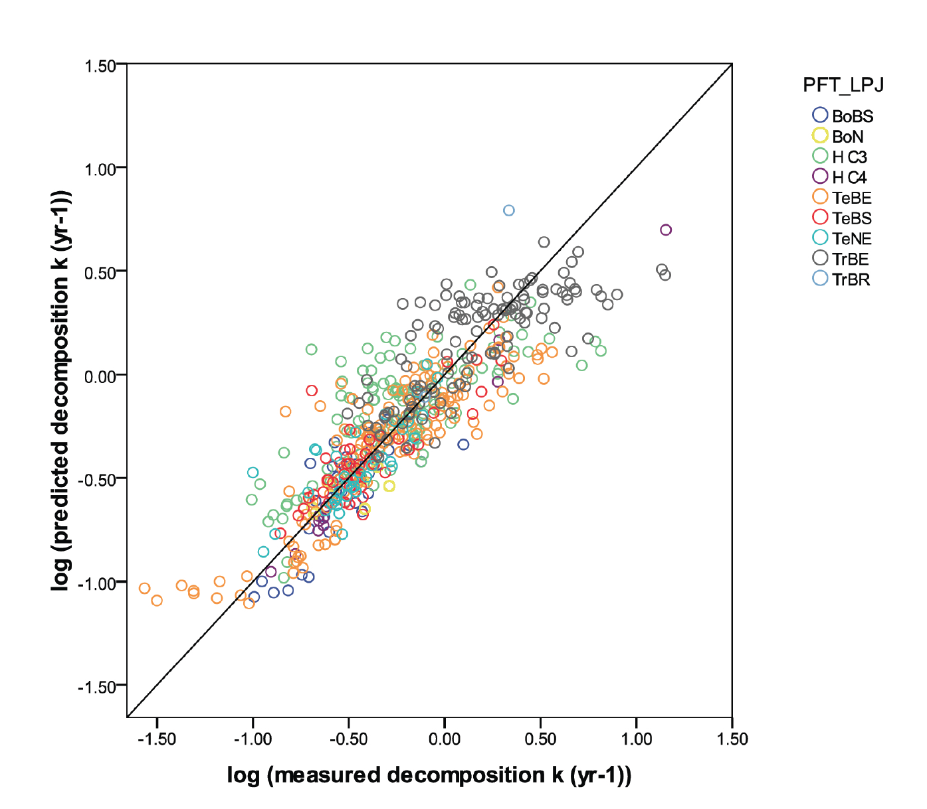
Observed and predicted litter decomposition rates based on new LPJ parameterization

Slide 43
Global distribution of litter stocks using original and new parameterisation
Original parameterization
New parameterization

Slide 44
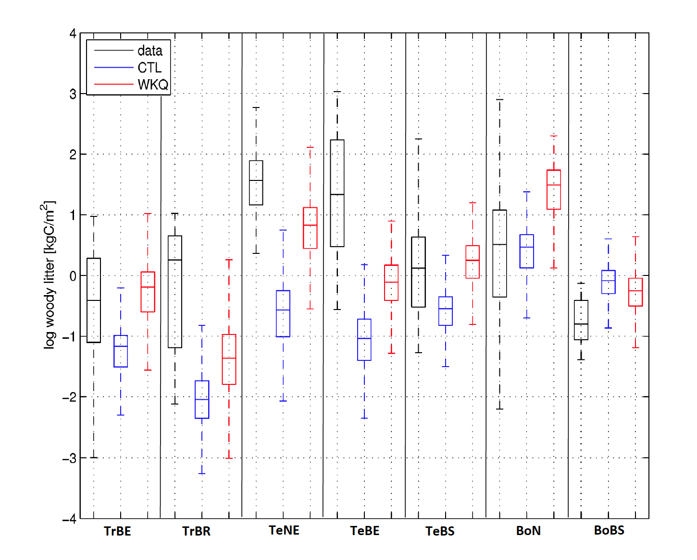
Comparison of observed and predicted woody litter stocks

Slide 45
Plant traits influencing soil properties
de Vries F. et al. (2012) Abiotic drivers and plant traits explain landscape-scale patterns in soil microbial communities. Ecology Letters
Demey A. et al. (2013) Nutrient input from hemiparasitic litter favors plant species with a fast-growth strategy. Plant and Soil
Garcia-Palacios P. et al. (2013) Climate and litter quality differently modulate the effects of soil fauna on litter decomposition across biomes. Ecology Letters

Slide 47
Variation of leaf N and LMA within plant functional types
Van Bodegom et al. 2012 GEB

Slide 48
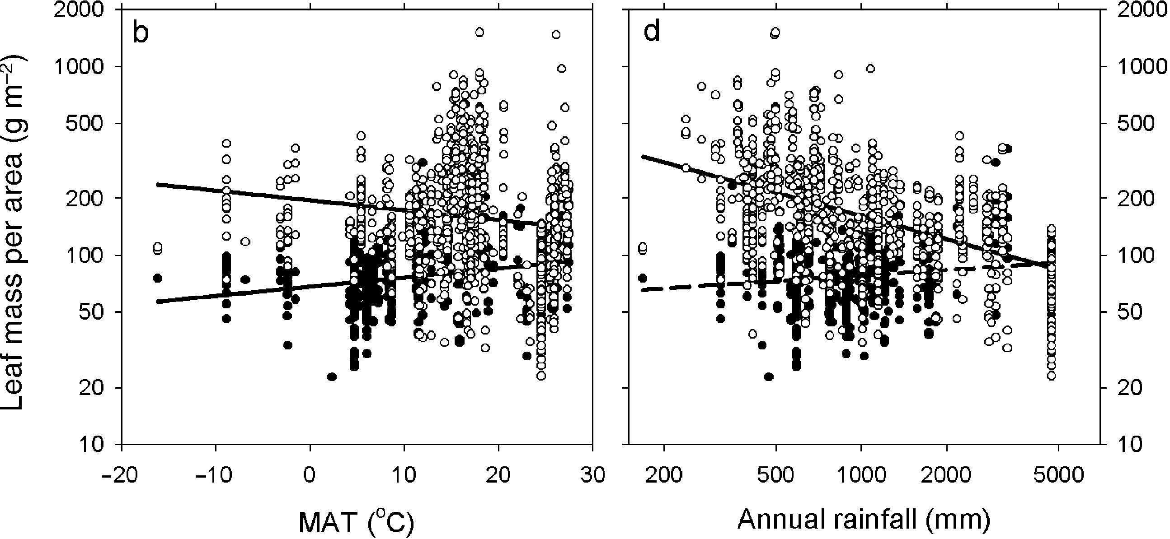
Trait-environment relationships:
large scatter – little signal
Evergreen trees (open circles): n=984, MAT: r²=0.02, Ann. rainfall: r²=0.22
Deciduous trees (closed circles): n=522, MAT: r²=0.08, Ann. rainfall: r²=0.02 n.s.
Wright et al. 2005 GEB

Slide 49
Parameters treated as function
of climate and soil
Specific leaf area (SLA)
Photosynthetic carboxylation capacity (Vcmax₂₅)
Photosynthetic electron transport capacity (Jmax₂₅)

Slide 50
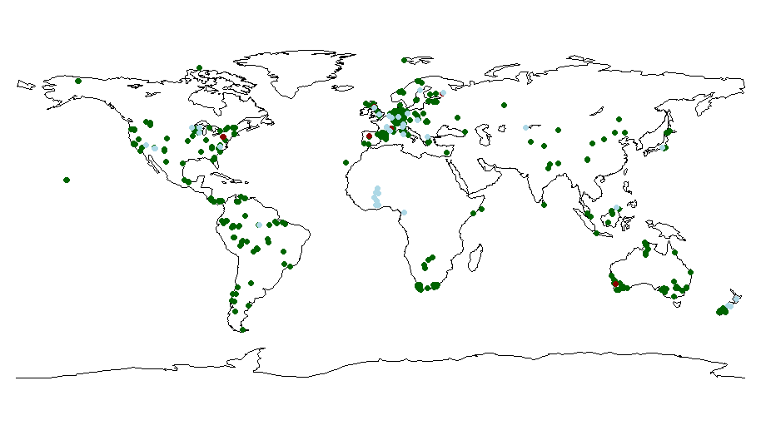
Global distribution of measurement sites
SLA Vcmax₂₅ & Jmax₂₅ Vcmax₂₅ only
Verheijen et al. 2013 BG

Slide 51
Trait – environment relationships
 | Sites, observations | Environmental covariates | R² | Lower, upper boundaries
SLA (m² kg⁻¹ carbon)
Tropical evergreen trees | 69 (933) | -MAP ,-NSWR | 0.092 | 7.41,48.29
Tropical deciduous trees | 38 (129) | -Tmin, -MAP, +Rh | 0.30 | 12.07,49.54
Extra-tropical evergreen trees | 363 (308) | +MAT, +MAP, -NSWR | 0.29 | 4.58,42.46
Extra-tropical deciduous trees | 177 (282) | -Tmax, -Rh | 0.056 | 6.24,90.50
Raingreen shrubs | 178 (696) | -MAP, -NSWR | 0.26 | 3.66,72.69
Cold/Deciduous shrubs | 39 (111) | +MAT | 0.13 | 17.82,61.53
C3-grasses | 153 (309) | +Tmax | 0.12 | 3.08,96.58
C4-grasses | 35 (101) | -NSWR | 0.4 | 5.41,72.19
Vcmax₂₅ (µmol m⁻² s⁻¹)
Tropical evergreen & deciduous trees | 9 (85) | +MAT, +MAP | 0.83 | 18.0, 67.7
Extra-tropical evergreen trees | 15 (284) | +MAT, -MAP, +Rh | 0.28 | 18.4,179.9
Extra-tropical deciduous trees | 19 (273) | -Rh, -SoilMoist | 0.34 | 18.2,130.0
Raingreen & Cold/Deciduous shrubs | 15 (75) | -MAP, -Rh | 0.45 | 25.1, 129.1
C3-grasses | 4 (15) | -MAT | 0.37 | 24.4, 118.4
C4-grasses | 8 (29) | +NSWR | 0.51 | 21.7, 46.3
Jmax₂₅ (µmol m⁻² s⁻¹)¹
Tropical evergreen & deciduous trees | 9 (51) | +MAT, +MAP | 0.68 | 35.8 , 121.6
Extra-tropical evergreen trees | 12 (113) | +Tmin, -MAP | 0.28 | 57.5, 329.6
Extra-tropical deciduous trees | 10 (135) | +Tmin, +NSWR | 0.71 | 41.1, 206.9
Raingreen & Cold/Deciduous shrubs | 13 (59) | +MAP, -SoilMoist | 0.64 | 65.4, 223.5
C3-grasses | 4 (15) | -MAT | 0.63 | 42.8, 230.6
C4-grasses | 8 (29) | +NSWR | 0.51 | 92.3, 465.4
¹ for C4-grasses: PEP (mmol m⁻² s⁻¹)
Verheijen et al. 2013 BG

Slide 52
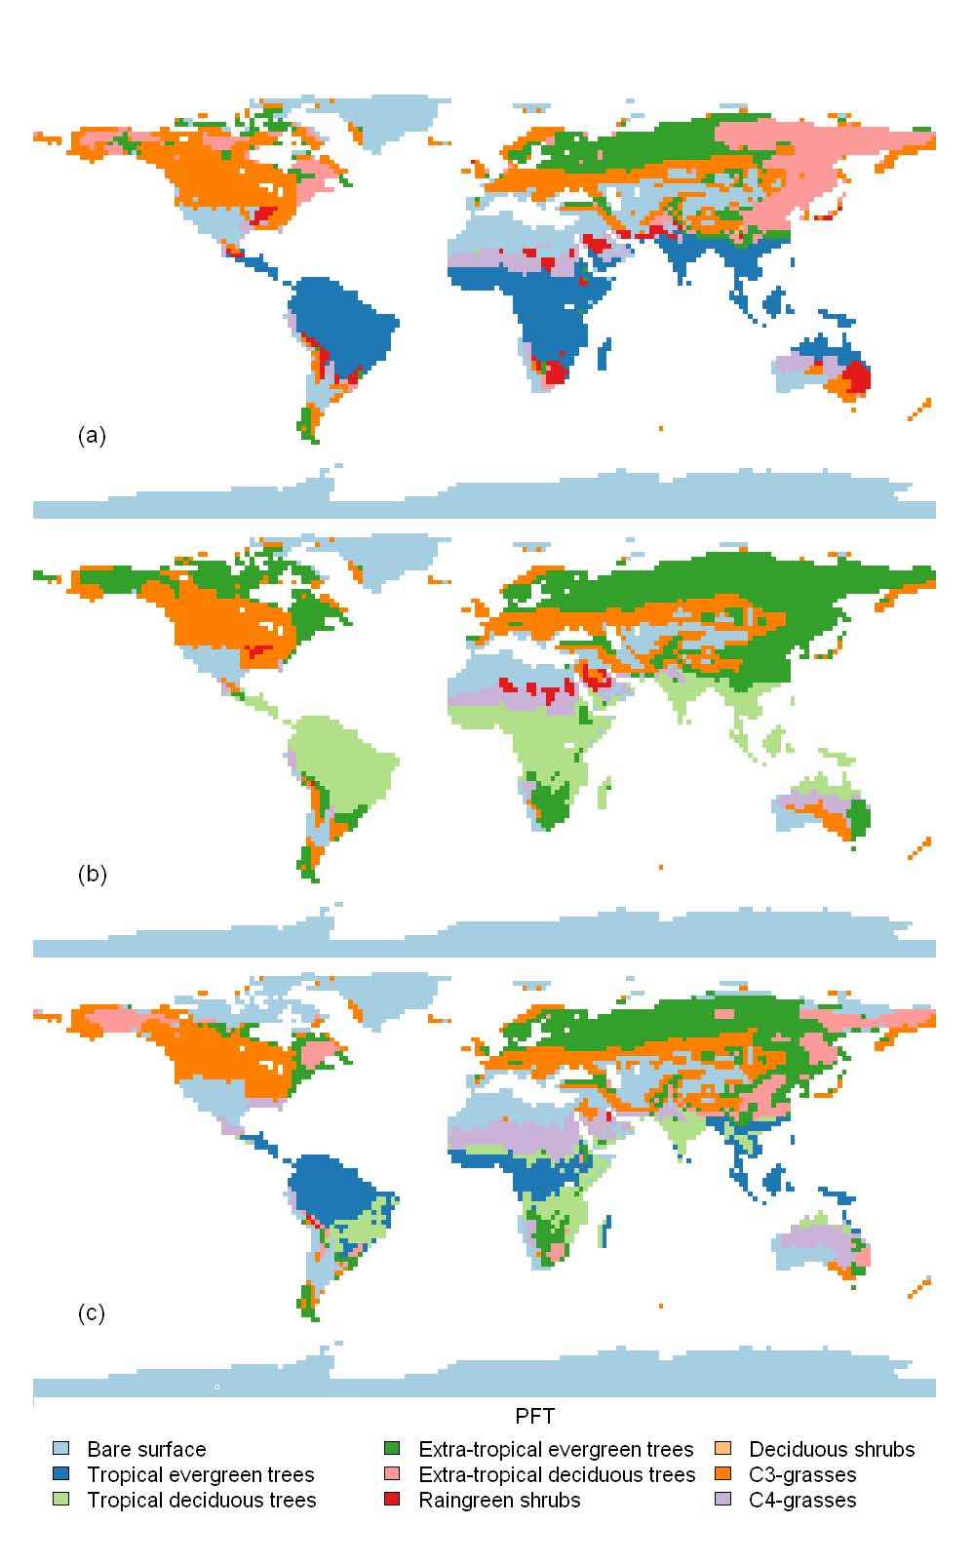
The variable parameter approach improves distribution of dominant PFTs
default model parameterization
observed mean parameters
variable parameters
observed distribution based on Ramankutty&Foley (1999)
Verheijen et al. 2013 BG

Slide 53
Terrestrial Biosphere
Plant traits and ecosystem modeling
9:00 – 10:30 Biogeochemical cycles modeling & plant traits
Introduction to Dynamic Global Vegetation Models
Traits as characteristics of plants
Plant traits to improve DGVMs
Towards a multivariate spectrum of plant form and function
11:00 – 12:00 Building a simple biogeochemical model (I)
14:00 – 17:00 Building a simple biogeochemical model (II)

Slide 54
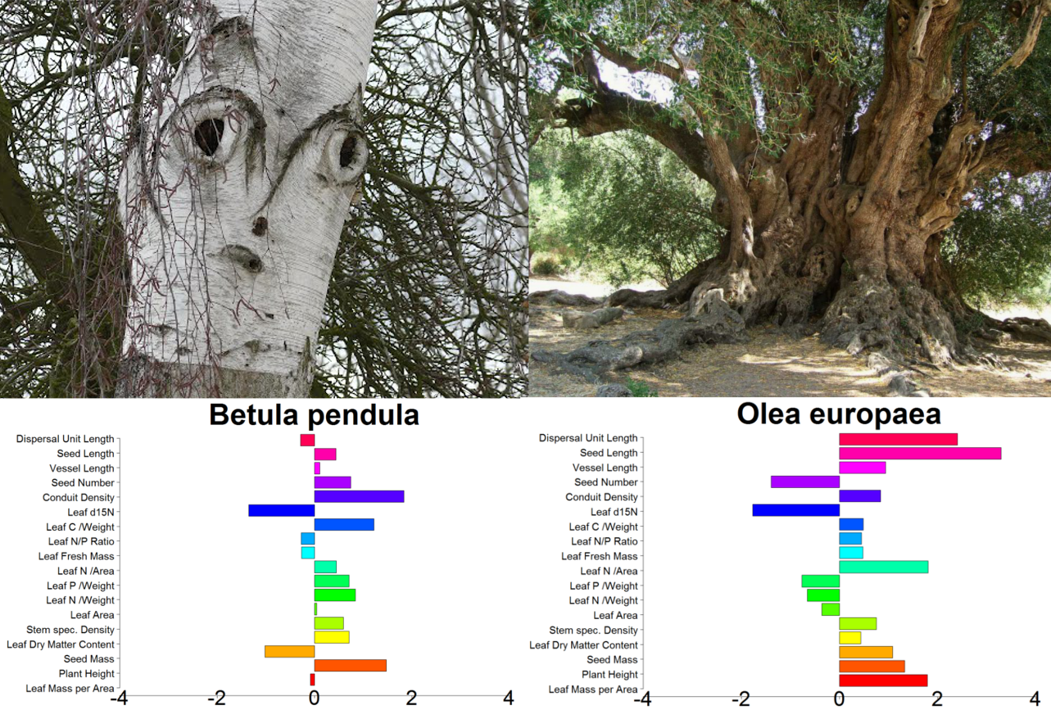
Traits don’t vary independently
Joswig, in prep.

Slide 55
Covariation of leaf N and LMA
Van Bodegom et al. 2012 GEB

Slide 56
Towards a multivariate spectrum of plant form and function
Leaf economic spectrum (Wright et al. 2004)
Wood economic spectrum (Chave 2009)
Coordination of leaf and woody litter decomposition (Pietsch 2012)
A world-wide ‘fast–slow’ plant economics spectrum (Reich 2014)
>>> no multivariate global analysis so far!!!

Slide 57
TRY - a sparse trait matrix
4.7 million measurements on 1000 traits × 2 million individuals (coverage 0.24 % )
Individual plants
Notes:
The point “Number of individuals with more than 3 traits available is uselessly small” is very important, since it is one of the main motivations for missing value prediction. It’s good to explain why more than 3 traits available is important to the community (because we need to see how the traits vary jointly, etc..). Can we use the traits correlation figure here to explain the point? (The current figure on sparsity is not that important, we can drop it if there is no space.)

Slide 58
Each additional trait reduces the number of species with complete coverage by 50%
n: number of species with complete coverage
n_{max}: maximum number of species
f_{joint}: average fraction of joint species
ntraits: number of traits
n=n_{max}*(f_{joint})^{ntraits}
n=n_{max}*(f_{joint})^{ntraits}
J. Kattge et al. (2011) Global Change Biology

Slide 59

Gap-filling: probabilistic matrix factorization a cooperation of the MPI-BGC with the Institute on the Environment and the Department of Computer Science and Engineering at the University of Minnesota
TRY = sparse matrix
4.7 million measurements on 1000 traits ×
2 million individuals (coverage 0.4 % )
Probabilistic Matrix Factorization (PMF)
N(0, σ_{v}²I)
v_{j}
X_{ij} ~ N(u_{i}^{T}v_{j} , σ²)
u_{i}^{T}
N(0, σ_{u}²I)
Individual plants
≈
U^{T}
*
V
R. Salakhutdinov and A. Mnih, NIPS 2007
Notes:
This is the page I used to explain PMF. You can copy paste some part of it to your slides if you want. We probably need to mention where U and V come from, since this is the main difference between PMF and HPMF.

Slide 60
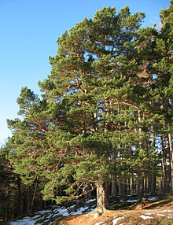
Taxonomic hierarchy of the plant kingdom
trait
…
X
…
phylogenetic group
family
genus
species
plant
Plant height
Rooting depth
Leaf area
Leaf Mass
LMA
LeafN content
Photosynthesis rates
etc..
e.g. Scots pine
Gymnosperms
Pinaceae
Pinus
Pinus sylvestris
Notes:
The purpose of this slides is two fold: first, we represent the data as a matrix, second, it has additional information as a hierarchy
It’s better to give a concrete example on the phylogenetic information. Say for a pine, what is it’s species, genus, family and phylogentic group…

Slide 61
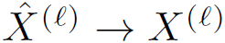
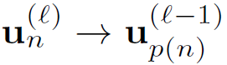
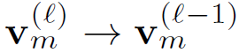
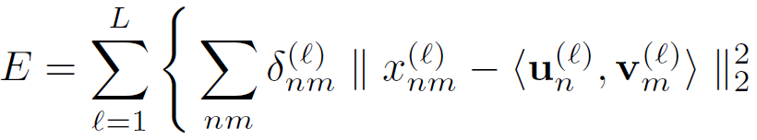
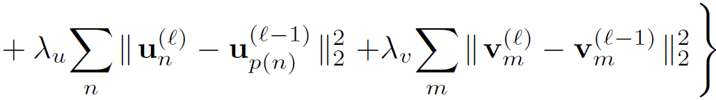
Hierarchical Probabilistic Matrix Factorization
V_{plant}
U_{plant}
V_{species}
U_{species}
genus
species
plant
H. Shan et al., ICML 2012
Notes:
Step 1: Show the “plant-trait matrix” --- What we have is this matrix
Step 2: Show X^{l} hat -> X^{l} --- At each level l, the matrix X is approximated by X hat.
Step 3: Show “species – trait ” matrix --- Based on the phylogenetic information we have, we can derive a “species – trait ” matrix
Step 4: Show U and V matrices --- At each level, we have a matrix factorization model
Step 5: Show u_n^{l} -> u_{p(n)}^{l-1} --- On the u side, the u for a certain plant should be close to the u for its species (child close to parent)
Step 6: Show v_m^{l} -> v_{m}^{l-1} --- On the v side, if the v at two levels correspond to a same trait m, they should be close.
Step 7: Show “genus-trait” matrix --- We can keep on doing the same thing for upper level matrices
Step 8: Show the equation at the bottom. The three terms correspond to the three items we showed on the right. The first term tries to minimizes the difference between the true matrix and the approximated matrix. The second term is the constraints on U. the third term is the constraints on V.

Slide 62
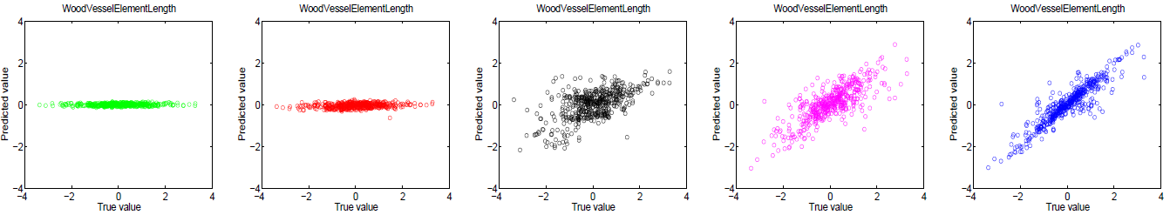
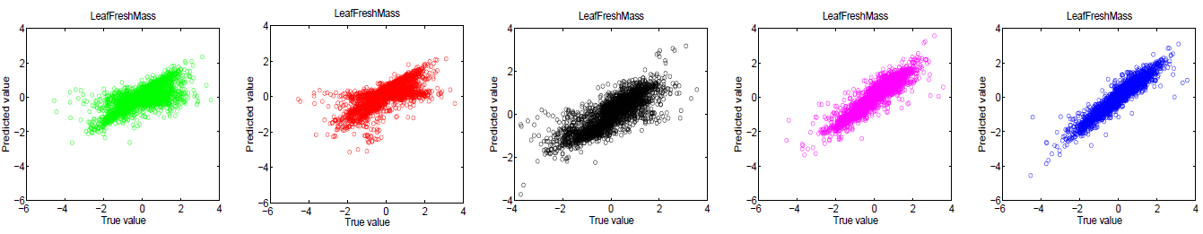
(true value, predicted value) scatter plot
Wood Vessel Element Length
no phylo. info. phylo.-group family genus species
Leaf Fresh Mass
With increasing amount of taxonomic information, the plot becomes closer to a 1:1 line
H. Shan et al., ICML 2012

Slide 63
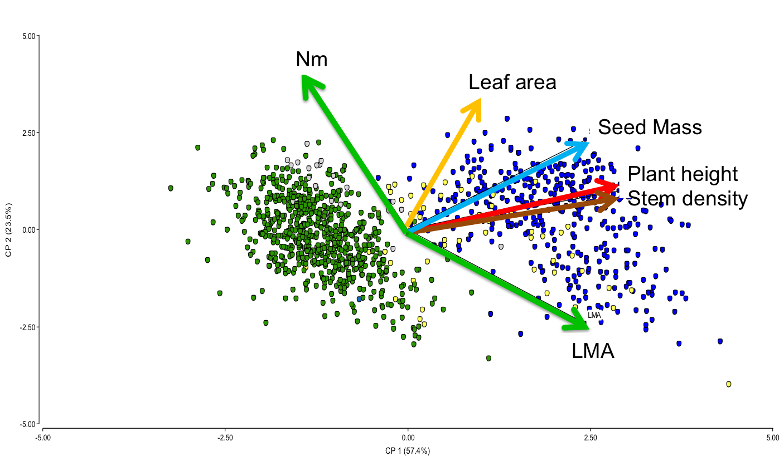
Unfolding the multivariate trait space observed: 6 traits, 1400 species
Diaz et al. in prep.

Slide 64
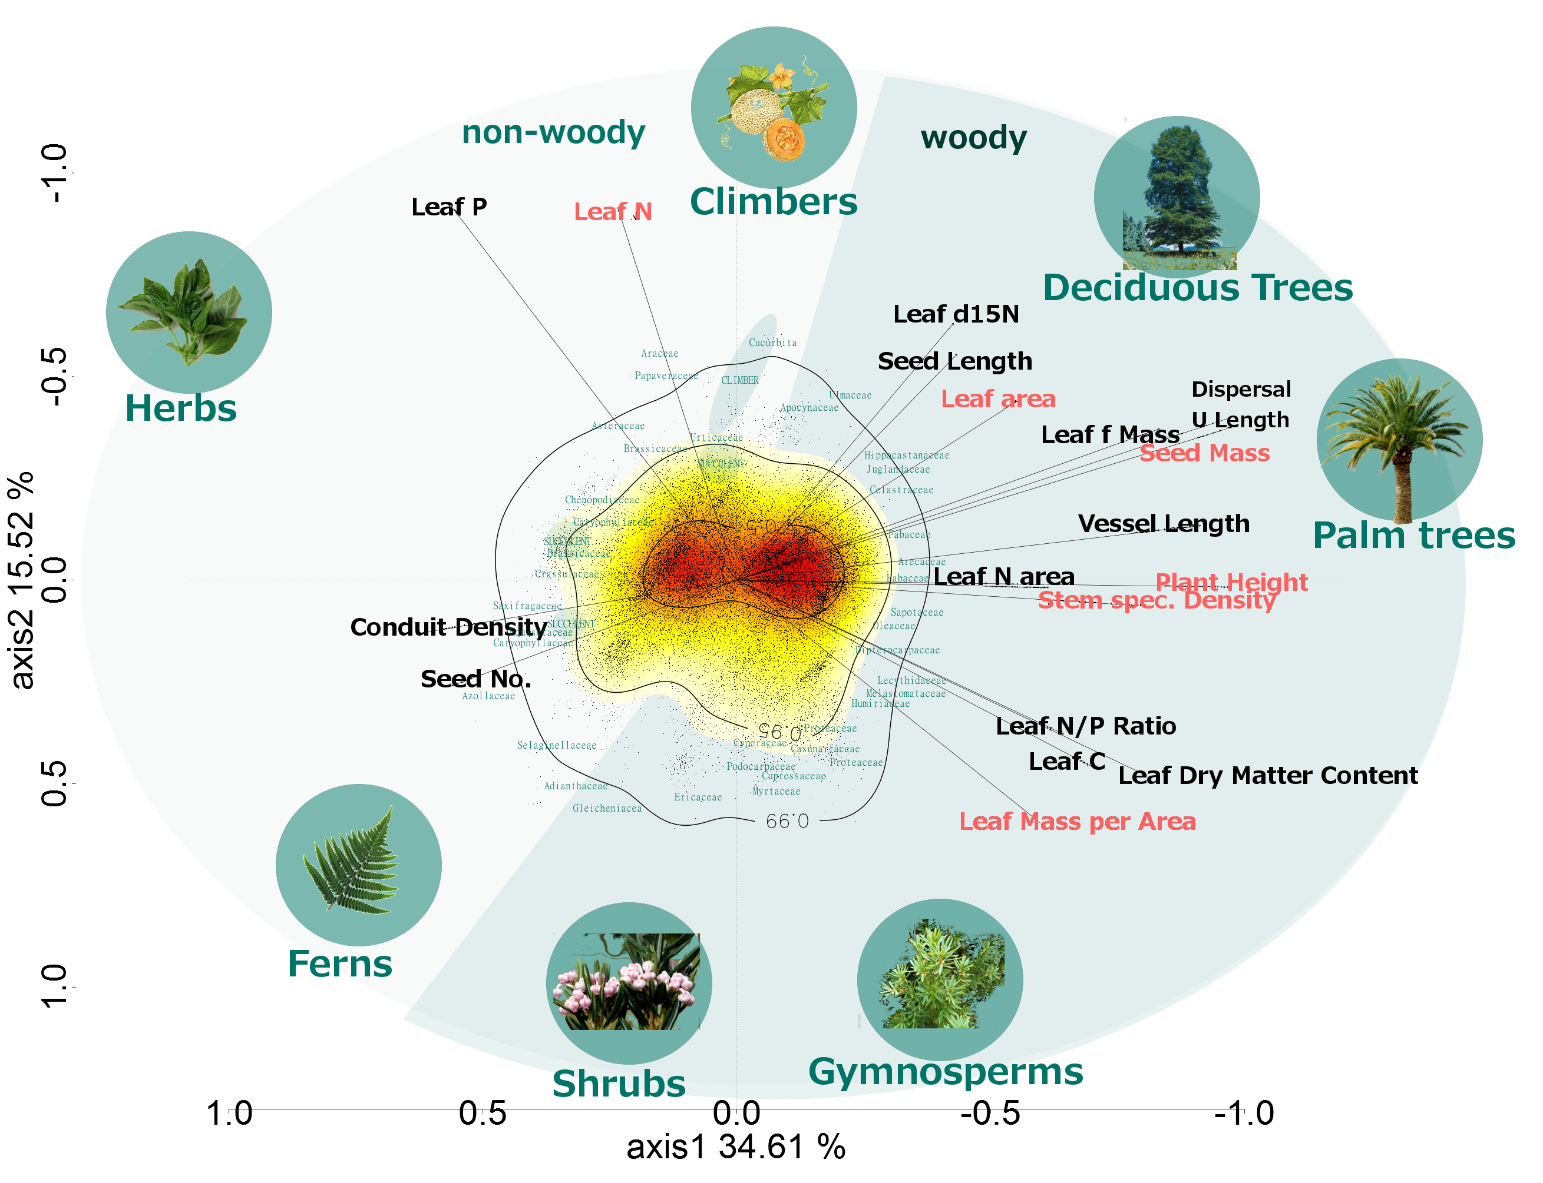
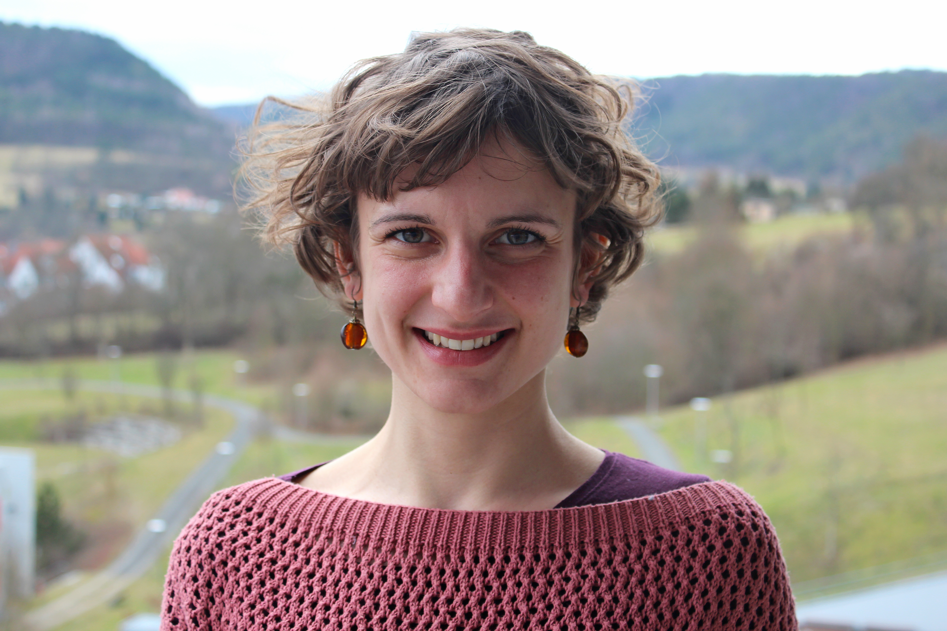
Unfolding the multivariate trait space 18 traits, 48000 species
Joswig, in prep.

Slide 65
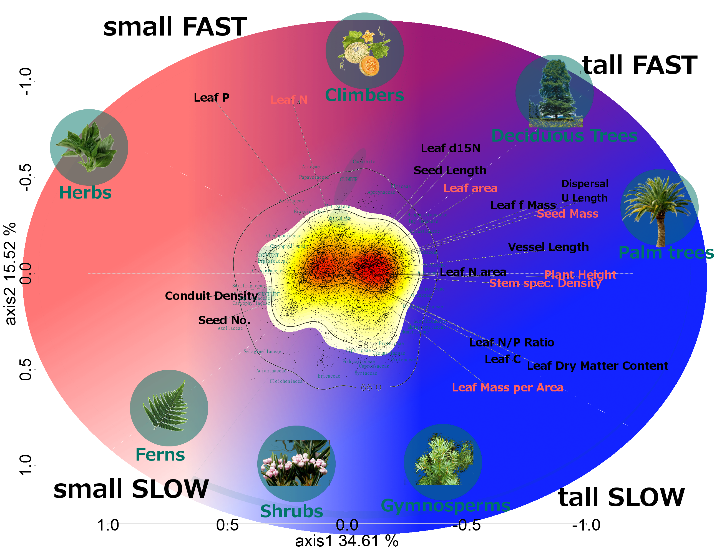
The ‘fast-slow’ plant economic spectrum
Joswig, in prep.

Slide 66
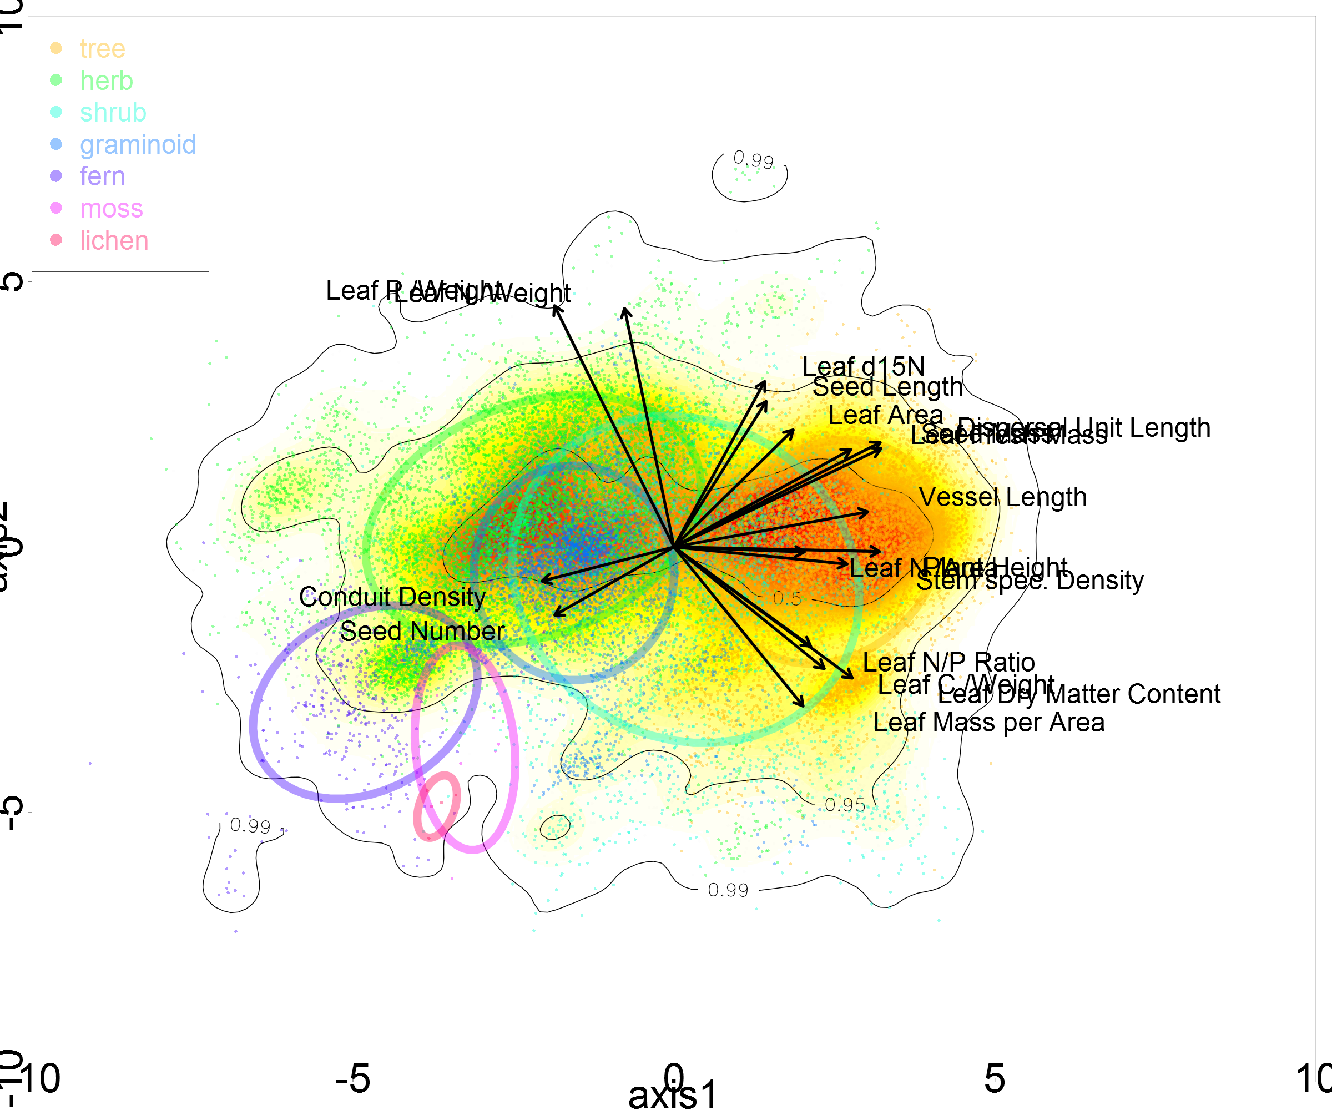
Plant Growth Forms
Joswig, in prep.

Slide 67
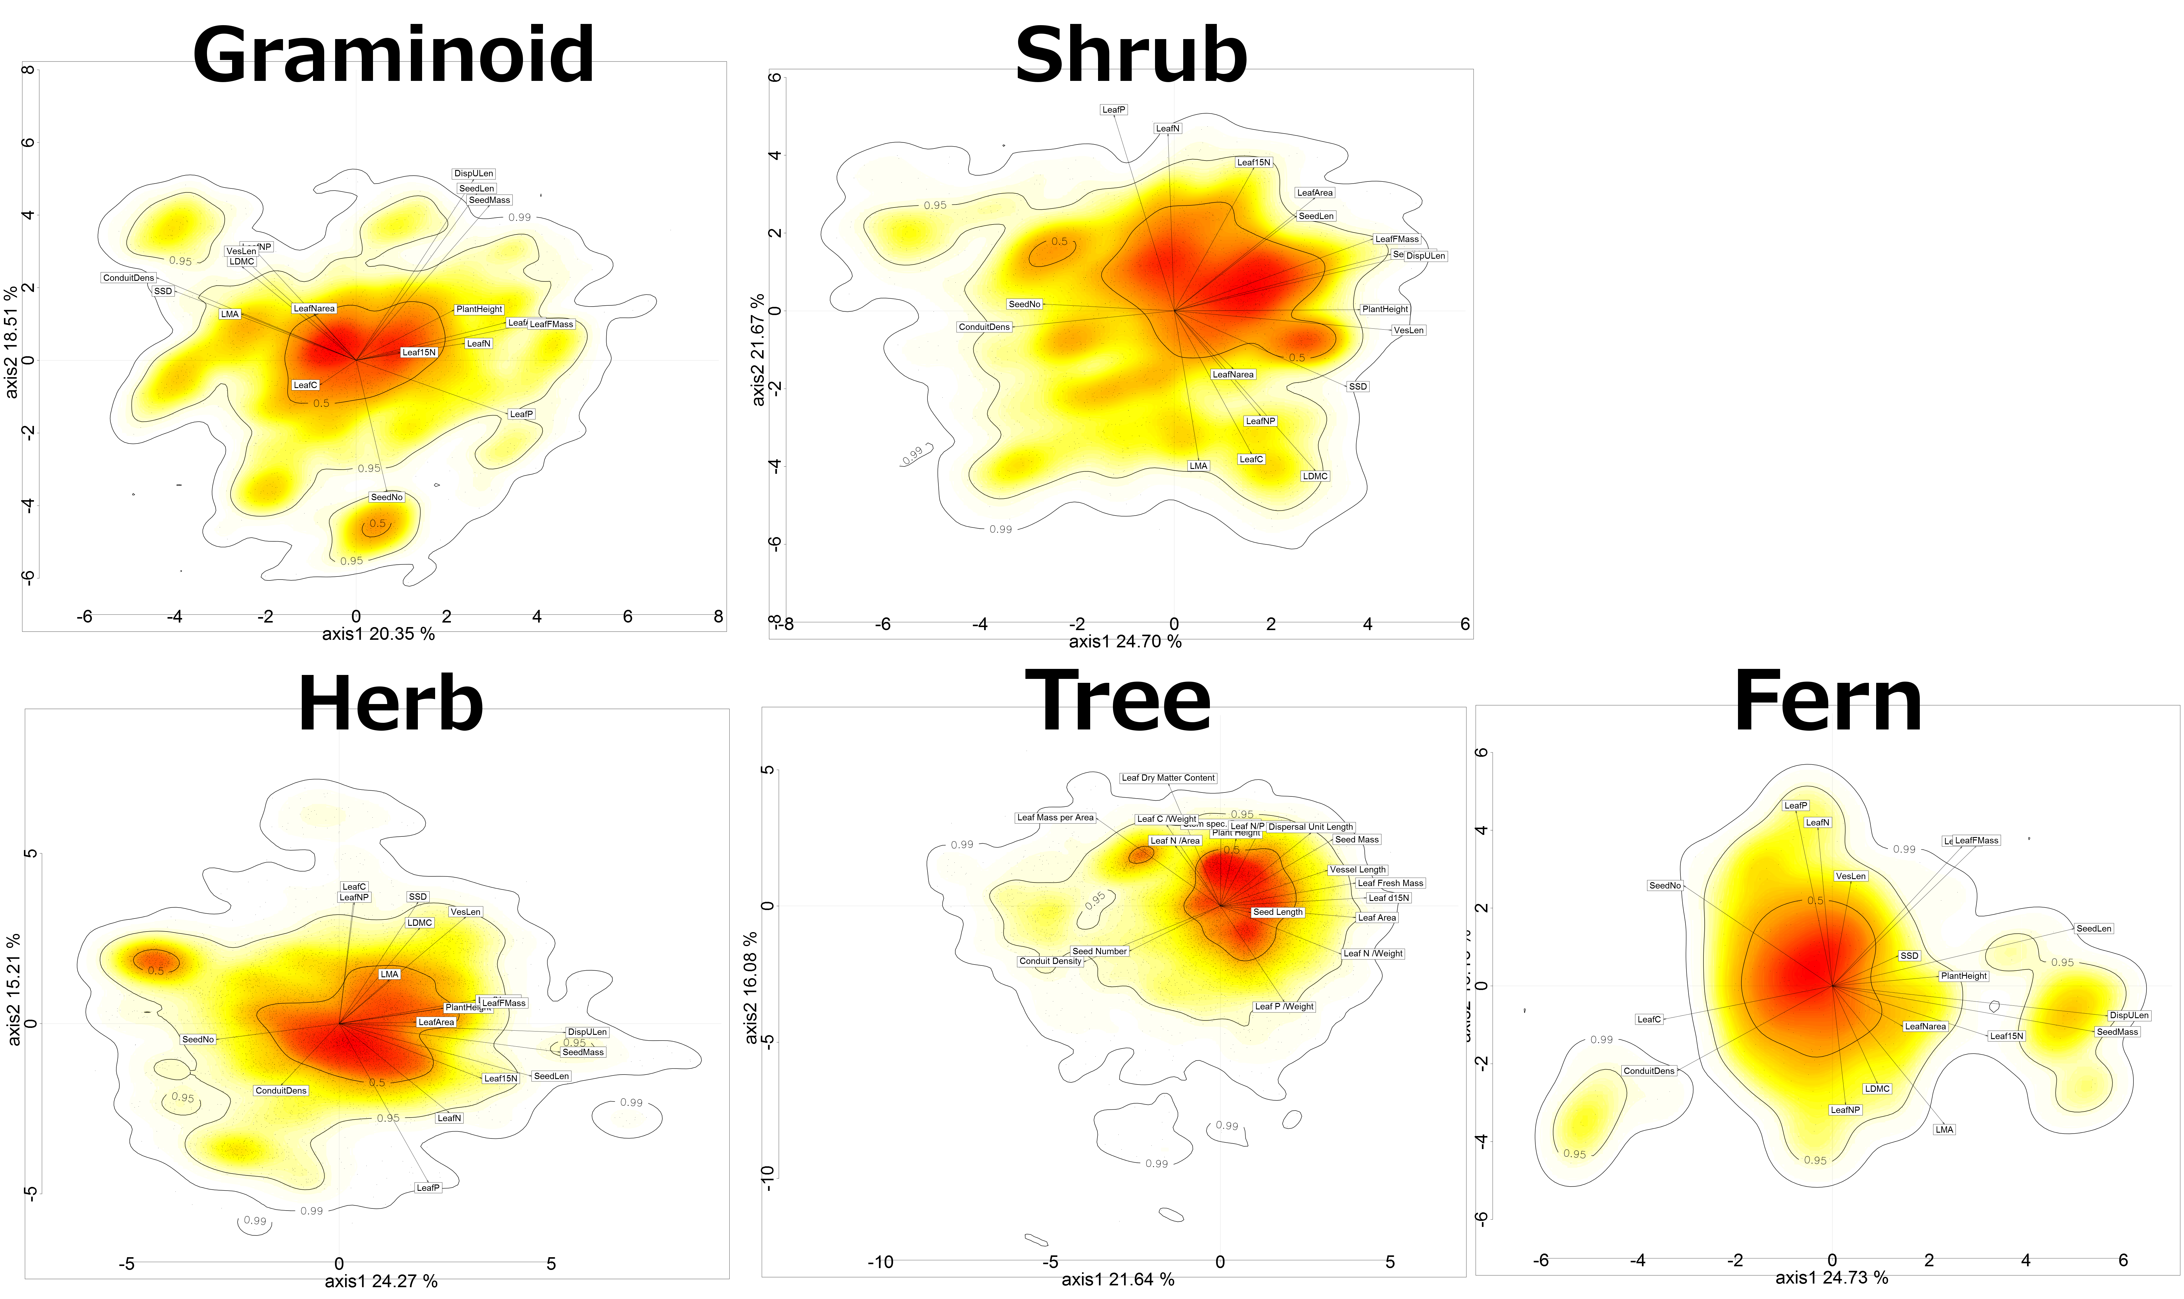
The coordination of traits within plant growth forms
Joswig, in prep.

Slide 68
Next Generation DGVMs
Representing the multivariate spectrum of plant form and function as the emergent property of adaptation to the environment
JeDi (Kleidon&Mooney 2000; Pavlik et al. 2013)
aDGVM2 (Scheiter et al. 2013)

Slide 69
The Jena Diversity-Dynamic Global Vegetation Model (JeDi-DGVM)
realized traits = f(functional trade-offs, habitat filtering)
Kleidon&Mooney, 2000 GCB; Pavlik et al. 2013, Biogeosciences

Slide 70
aDGVM2: introducing trait evolution by community assembly
traits = f(mutation/cross-over, competitive habitat filtering)
Scheiter et al. 2013, New Phytologist

Slide 71
The terrestrial biosphere is only a small component of Earth system models: the MPI-Earth System Model
ECHAM6
Carbon
Energy
Momentum
Energy
Momentum
Water
JSBACH
OASIS
Water
HAMOCC
MPIOM
MPI-ESM

Slide 72
Terrestrial Biosphere
Plant traits and ecosystem modeling
9:00 – 10:30 Biogeochemical cycles modeling & plant traits
Introduction to Dynamic Global Vegetation Models
Traits as characteristics of plants
Plant traits to improve model parameterization and introduce diversity & adaptation
11:00 – 12:00 Building a simple biogeochemical model (I)
14:00 – 17:00 Building a simple biogeochemical model (II)
Thank you

